Slide 1

October 19th to 25th presentation
Tangaza Dev Club

Slide 2
CSS text formatting
In CSS text formatting we have different styles you can add to the text.
For example:
Color
Background-color
Text-alignment
Text-decoration
Text-transformation
Text-spacing
Text-shadow

Slide 3
Text color
Background-color
You can add the text background color using;
Body {
Background-color: yellow;
}
Color of the text
Body {
Color: green;
}

Slide 4
Text alignment and decoration
Text-alignment
It can align the text t the right or to the left or even the centre.
Body {
Text-alignment: centre;
}
Text-decoration
It is commonly used when removing the styles usually underlines to the links. And when adding styles to the text like underline, strikethrough etc.
a {
Text-decoration: none;
}
h1 {
Text-decoration: underline;
}

Slide 5
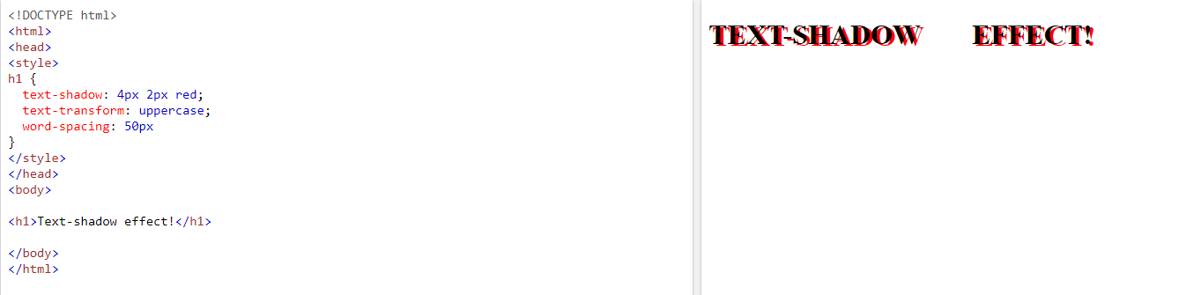
Text transformation, spacing and shadow
Text-transformation
You can change the text to capital letters using uppercase or the opposite using lowercase and to make each word of the sentence capital you use capitalize.
Text spacing
The spaces between the words and letters of the word can be changed using word-spacing and letter-spacing respectively.
Text shadow
You can add the shadow effect to the text using text-shadow. The first value is for the right, the second for the bottom and the third for the color.

Slide 6
Text fonts
Font-family
This changes the font family of the text for example Calibri. You can use different fonts.
Font-styles
The different font styles include italics, normal, oblique.
Font- weight
Font weight property makes the text thicker or less thick for example bold, 700px etc.
Font-variant
You can make the uppercase font look smaller.
Font-size
This property changes the font-size to either larger or even smaller.

Slide 7
Links
To make a link you use a and href and if you want you add styles.
a {
Color: blue;
}
When adding the styles about visited and unvisited links you should use the code format below.
/* unvisited link */ a:link { color: red; } /* visited link */ a:visited { color: green; } /* mouse over link */ a:hover { color: hotpink; } /* selected link */ a:active { color: blue; }

Slide 8
Lists
When making a list, you use ordered and unordered list format ol and ul respectively.
You can change the list numbering and bulleting by:
For the unordered list, it’s list-style-type: circle;
You can use an image as the bulleting using: list-style-image: url(‘wallpaper 3.jpg');
Or any shape you want to put.
And as for the ordered list it’s list-style-type: lower-roman;
Or upper-roman, upper-alpha or lower-alpha etc.
Normal styles can also be added for example color and background-color etc.

Slide 9
Icons
To use font awesome icons you have to login to font-awesome and use it as:
<script src="https://kit.fontawesome.com/a076d05399.js"></script> </head> <body> <i class="fas fa-cloud"></i> <i class="fas fa-heart"></i> <i class="fas fa-car"></i> <i class="fas fa-file"></i> <i class="fas fa-bars"></i>

